Slide 1
Delegates in C#
Sarita Lad
DATE

Slide 2
Delegates in C#
What is delegate?
What is the use of delegate?
1 To pass method as a paramter :use delegate
2 To execute multiple methods at once ,we use multicaste delegate
System defined deleagtes

Slide 3
What is delegate?
A delegate is a type safe function pointer. i.e. it holds a reference to the function.
The signature of delegate must match to the signature of function to which it points to.
This is the reason delegates are called type safe function pointers.
A delegate is similar to a class. You can create instance of it. You can pass in the name of function as a parameter to the delegate constructor.
And it is to this function the delegate will point to.

Slide 4
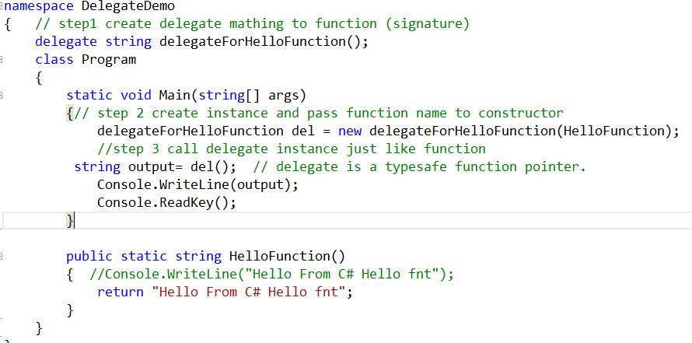
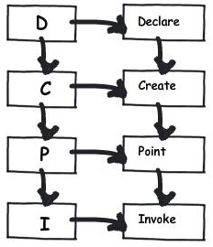
Delegate is type safe function pointer?

Slide 5
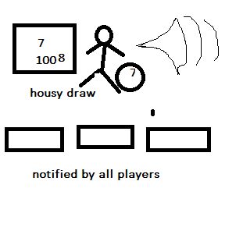
Multicast delegate

Slide 6
What is Anonymous method in C#
As the name suggests, an anonymous method is a method without a name. Anonymous methods in C# can be defined using the delegate keyword and can be assigned to a variable of delegate type.

Slide 7
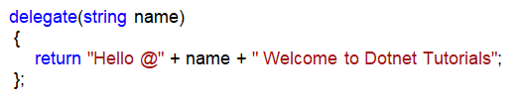
Why do we need Anonymous Methods in C#?
We create one delegate (transformer)
Then we instantiate the delegate, while we are instantiating the delegate, we are passing the Method name as a parameter to the constructor of the delegate
Finally, we invoke the delegate
As of now, this is the approach we are following to bind a method to a delegate and execute. An anonymous method is also related to a delegate. Without binding a named block (function) to a delegate, we can also bind a code block to a delegate means an unnamed code blocked to a delegate which is nothing but an anonymous method in C#.

Slide 8
1 Declare delegate Ex: delegate void SumDel(int a,int b); 2 Define Method and assign to delobj ( in main function ) SumDel obj=delegate(int a,int b) { Console.WriteLine(“Sum = “+(a+b)); } 3 call it by passing parameters to delobject obj(2,4);
Syntax of anonymous method:

Slide 9
What are the Limitations of Anonymous Methods in C#?
Advantages :
We do not need to declare data type of input variable
An anonymous method in C# cannot contain any jump statement like goto, break or continue.
It cannot access the ref or out parameter of an outer method.
The Anonymous methods cannot have or access the unsafe code.

Slide 10
Points to Remember while working with the Anonymous Methods in C#:
The anonymous methods can be defined using the delegate keyword
An anonymous method must be assigned to a delegate type.
This method can access outer variables or functions.
An anonymous method can be passed as a parameter.
This method can be used as event handler.

Slide 11
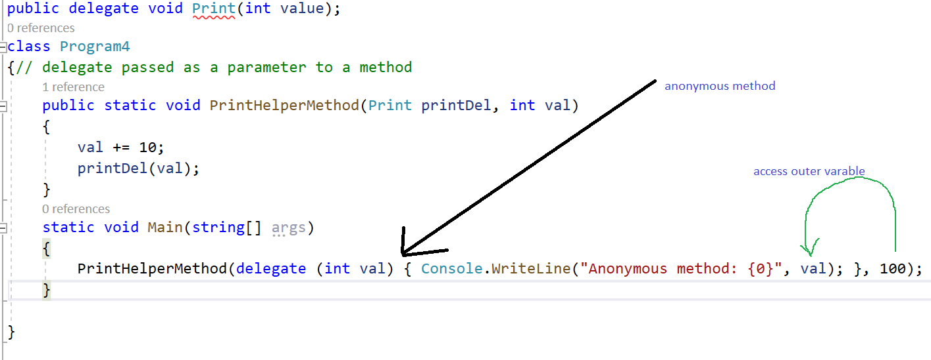

Slide 12
What is Lambda Expression?
A Lambda expression is an anonymous method. That means, it’s a method that has no access modifier, no name, and no return statement.
With Lambda expressions we can write less code, and the code will be more readable.
A lambda expression uses the lambda operator => which means goes to.
Syntax:
arguments => expession

Slide 13
delegate string mydel(string nm);//unicaste delegate
static void Main(string[] args)
{
mydel obj = delegate (string name) //anonymous method
{
return "Welcome " + name;
};
Console.WriteLine(obj("Sarika"));
Console.WriteLine(obj(“Synergetics"));
//
mydel obj1 = (string companyname) => { return "Welcome to " + companyname; };
Console.WriteLine(obj1(“Synergetics"));
}

Slide 14
ExpressionLambda and statement Lambda
Expression lambda that has an expression as its body:
(input-parameters) => expression
Statement lambda that has a statement block as its body:
(input-parameters) => { <sequence-of-statements> }

Slide 15
Lambda Expression:
class Program
{
static void Main(string[] args)
{
// Using lambda expression
// to calculate square of
// each value in the list
var square = numbers.Select(x => x * x);
// foreach loop to display squares
Console.Write("Squares : ");
foreach (var value in square)
{
Console.Write("{0} ", value);
}
}

Slide 16
What are Generic Delegates in C#?
The Generic Delegates in C# were introduced as part of .NET Framework 3.5 which doesn’t require defining the delegate instance in order to invoke the methods. To understand the Generic Delegates in C# you should have the basic knowledge of Delegates.
Types of Generic Delegates in C#
C# provides three built-in generic delegates, they are
Func
Action
Predicate

Slide 17
Why do we need the Generic Delegates in C#?
C# provides some generic delegates who can do the job for us. C# provides three Generic Delegates, they are as follows
Func
Action
Predicate

Slide 18
What is Func Generic Delegate in C#?
The Func Generic Delegate in C# is present in the System namespace. This delegate takes one or more input parameters and returns one out parameter. The last parameter is considered as the return value. The Func Generic Delegate in C# can take up to 16 input parameters of different types. It must have one return type. The return type is mandatory but the input parameter is not.
Note: Whenever your delegate returns some value, whether by taking any input parameter or not, you need to use the Func Generic delegate in C#.

Slide 19
What is Action Generic Delegate in C#?
The Action Generic Delegate in C# is also present in the System namespace. It takes one or more input parameters and returns nothing. This delegate can take a maximum of 16 input parameters of the different or same type
Note: Whenever your delegate does not return any value, whether by taking any input parameter or not, then you need to use the Action Generic delegate in C#.

Slide 20
What is Predicate Generic Delegate in C#?
The Predicate Generic Delegate in C# is also present in the System namespace. This delegate is used to verify certain criteria of the method and returns the output as Boolean, either True or False. It takes one input parameter and always returns a Boolean value which is mandatory. This delegate can take a maximum of 1 input parameter and always return the value of the Boolean type.
Note: Whenever your delegate returns a Boolean value, by taking one input parameter, then you need to use the Predicate Generic delegate in C#

Slide 21
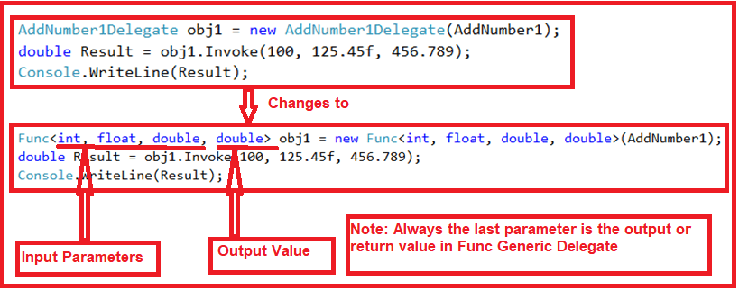

Slide 22
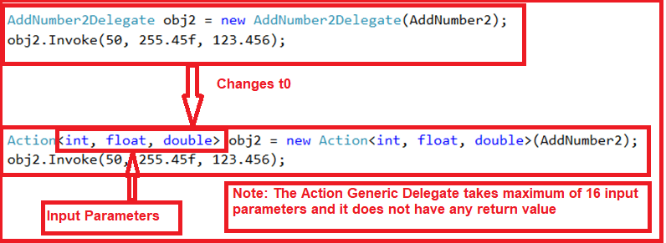

Slide 23
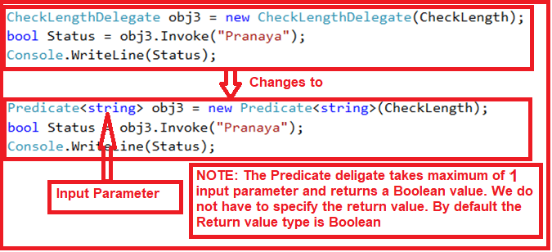

Slide 24
Points to remember while working with C# Generic Delegates:
Func, Action, and Predicate are generic inbuilt delegates that are present in the System namespace which is introduced in C# 3. All these three delegates can be used with the method, anonymous method, and lambda expressions. The Func delegates can contain a maximum of 16 input parameters and must have one return type. Action delegate can contain a maximum of 16 input parameters and does not have any return type. The Predicate delegate should satisfy some criteria of a method and must have one input parameter and one Boolean return type either true or false which is by default. This means we should not have to pass that to the Predicate

Slide 25
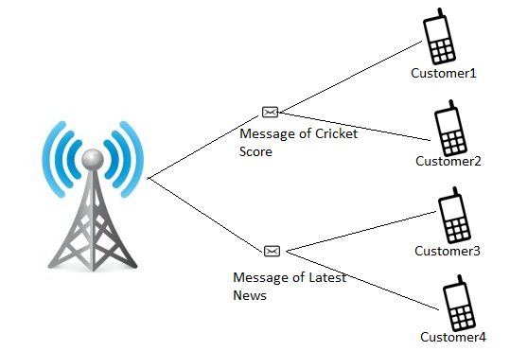
Events and Delegates

Slide 26
As in the preceding image a Mobile operator publishes (broadcasts) messages (a message of a Cricket score and a message of latest news) and the messages are captured by the customer cells subscribing to the messages (Customer1 and Customer2 captures the Cricket score messages and Customer3 and Customer4 captures the latest news messages).

Slide 27
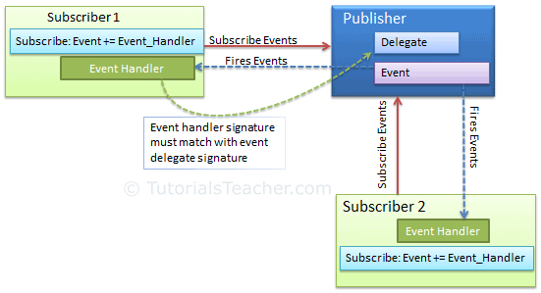

Slide 28
A publisher is an object that contains the definition of the event and the delegate. The event-delegate association is also defined in this object. A publisher class object invokes the event and it is notified to other objects.
A subscriber is an object that accepts the event and provides an event handler. The delegate in the publisher class invokes the method (event handler) of the subscriber class.

Slide 29
Thank You

Slide 30
Lambda Expression with Linq Methods
Single() / SingleOrDefault() | First () / FirstOrDefault()
Single() - There is exactly 1 result, an exception is thrown if no result is returned or more than one result. SingleOrDefault() – Same as Single(), but it can handle the null value. | First() - There is at least one result, an exception is thrown if no result is returned. FirstOrDefault() - Same as First(), but not thrown any exception or return null when there is no result.
Single() asserts that one and only one element exists in the sequence. | First() simply gives you the first one.
When to use Use Single / SingleOrDefault() when you sure there is only one record present in database or you can say if you querying on database with help of primary key of table. | When to use Developer may use First () / FirstOrDefault() anywhere, when they required single value from collection or database.
Single() or SingleOrDefault() will generate a regular TSQL like "SELECT ...". | The First() or FirstOrDefault() method will generate the TSQL statment like "SELECT TOP 1..."
In the case of Fist / FirstOrDefault, only one row is retrieved from the database so it performs slightly better than single / SingleOrDefault. such a small difference is hardly noticeable but when table contain large number of column and row, at this time performance is noticeable.

